Slide 1
Operating System
Chapter 1-1: Introduction
宫晓利
Department of Computer Science, NanKai University
Email: gongxiaoli@nankai.edu.cn
微信：nkgongxl

Slide 2
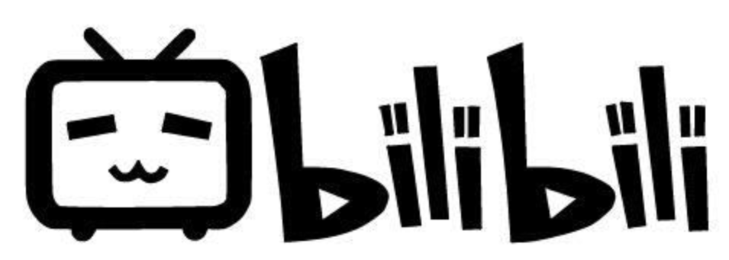

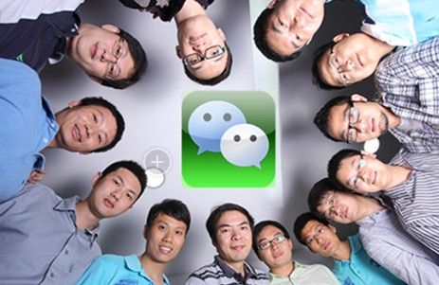
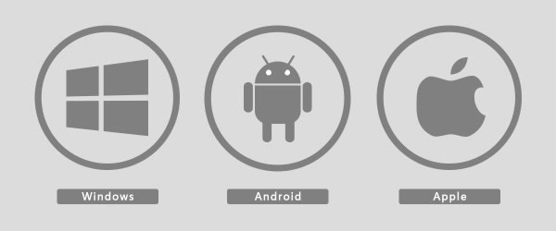
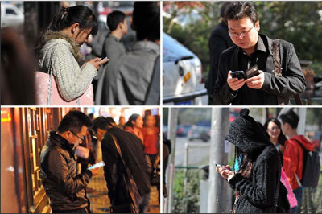
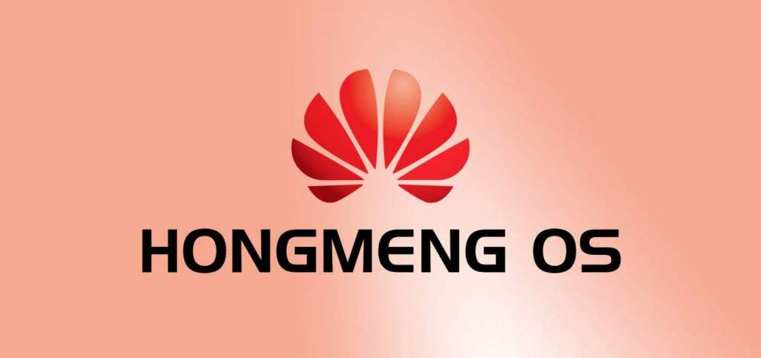
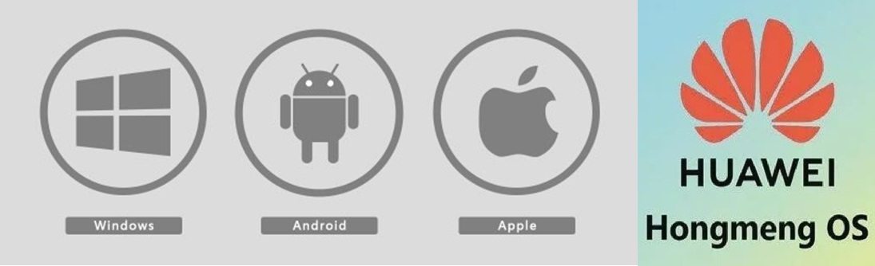
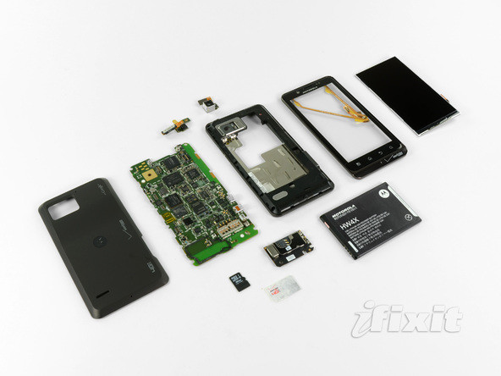
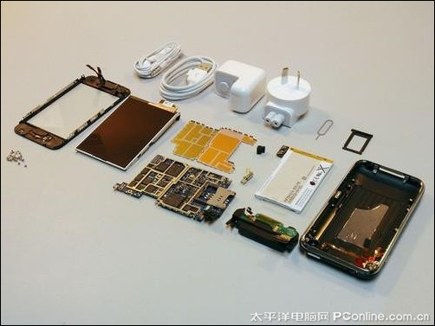

Slide 3
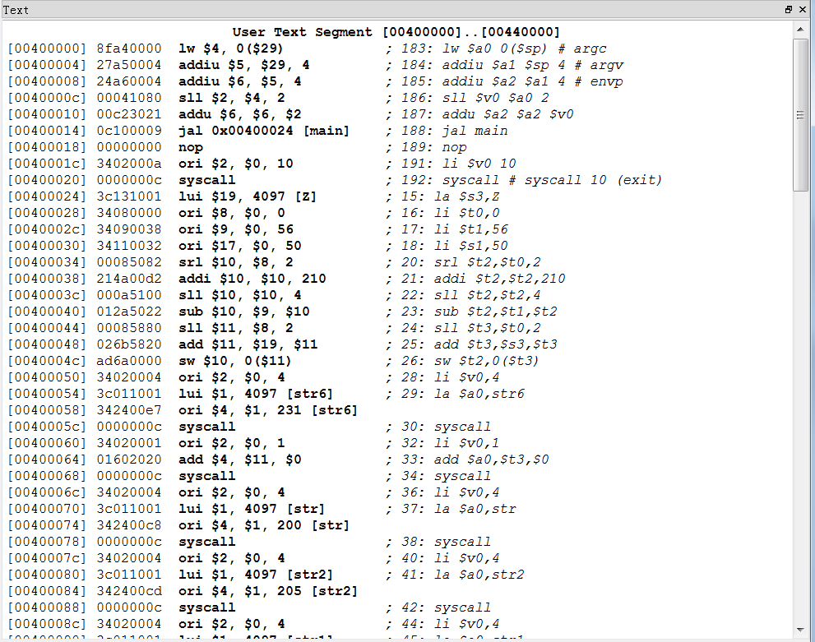
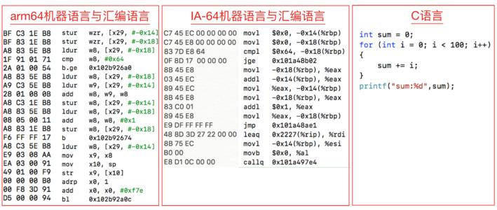
几个值得思考的小问题
每一部手机的硬件是一样的吗？
CPU、内存、地址排布。。。。
每一个手机上安装的程序是一样的吗？
抖音、微信、B站是否为每一款手机开发了一个app?
组成原理、汇编语言课程上，你的程序是怎么写的？
为什么程序可以不用考虑硬件的差异?
这是如何实现的？

Slide 4
What is OS?
Operating
Drive all hardware devices in computer
Manage all software in computer
Provide proper service environment
System
Virtual machine and resource manager
theories, mechanisms, algorithms and techniques
My opinion
CPU is the heart of computer
OS is the soul of computer

Slide 5
What happens behind “Hello World”
#include <iostream>
using namespace std;
int main(int argc, char *argv[])
{
cout<<"hello world";
return 0;
}

Slide 6
Processing steps of OS
Human-Computer Interaction
Input the content of the program (keyboard)
Command IDE to compile the program (mouse)
Output the exe file to disk (file system)
Question 1: How can computer know your input?
Question 2: How can IDE compile and generate exe files?
Exe file loading
Create a thread to run the program (Thread)
Load the Exe file from disk to memory (Memory)
Schedule the thread to occupy CPU time (Thread)
Question 3: How to allocate memory for a thread?
Question 4: How to schedule the thread?
Program running
Load instruction from memory to CPU register (Thread)
Execute the first instruction of the program
Question 5: The mechanism of instruction execution

Slide 7
Processing steps of OS (cont.)
Interaction between Graphic card and CPU
Load graphic card driver (I/O device)
Set the content to be displayed (BUS & DMA)
Question 6: The working mode of driver and BUS&DMA
Print the string on monitor
Convert the string to be pixel-matrix (I/O device)
Start printing….
Question 7:The working mode of monitor
Exiting steps
Block the graphic driver thread, it will wait for next calling
Release all resource allocated for “hello world” program
Load next thread, or sleep until next command reached….
Overview of this example
All modules of OS kernel are activated
OS is the basement for almost all programs

Slide 8
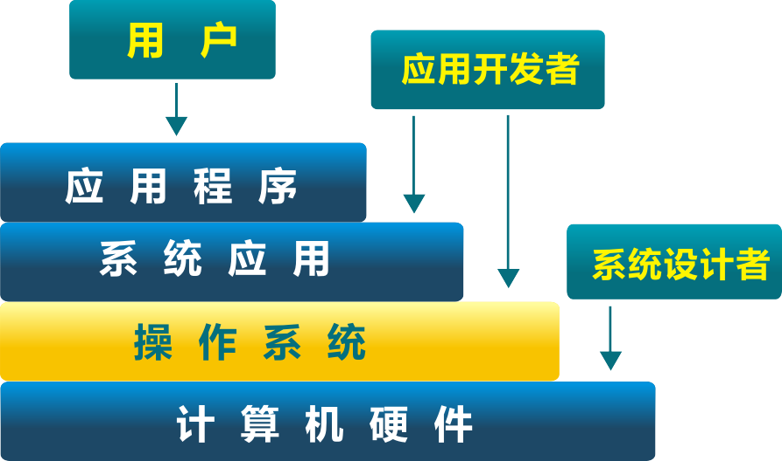
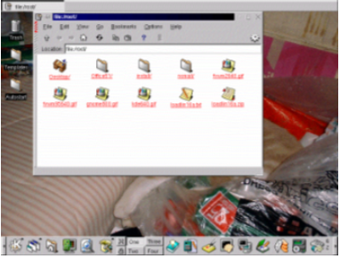
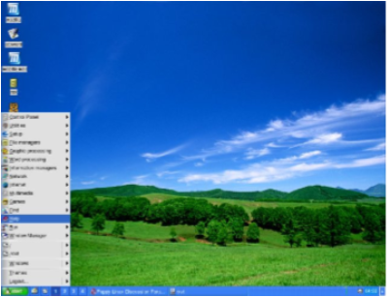
操作系统的地位

Slide 9
Concept of Software

Slide 10
Role of OS in computer system
处理结果
如何使用？
底层硬件控制
用户输入
计算机硬件设备

Slide 11
Functions of OS
Hardware abstraction
Provide unified, friendly UI for users
Hide the configuration difference of hardware components
Application integration
Provide simple and useful methods for programs designing
Schedule and control the running of programs
Environment management
Monitor whole environment of computer
Provide a secure, stable and comfortable space for uses
OS
Hardware

Slide 12
Architecture of OS
Programming
interface
Basic concept
File system
OS
CPU management
Memory management
Device management

Slide 13
Architecture of Minix
Init
进程
用户
进程
用户
进程
用户
进程
用户
进程
……
Level 4
User space
内存
管理器
文件
系统
网络
服务器
……
Service
Level 3
磁盘
任务
终端
任务
时钟
任务
系统
任务
以太网
任务
……
Level 2
I/O Task
进程管理
Level 1
Kernel

Slide 14
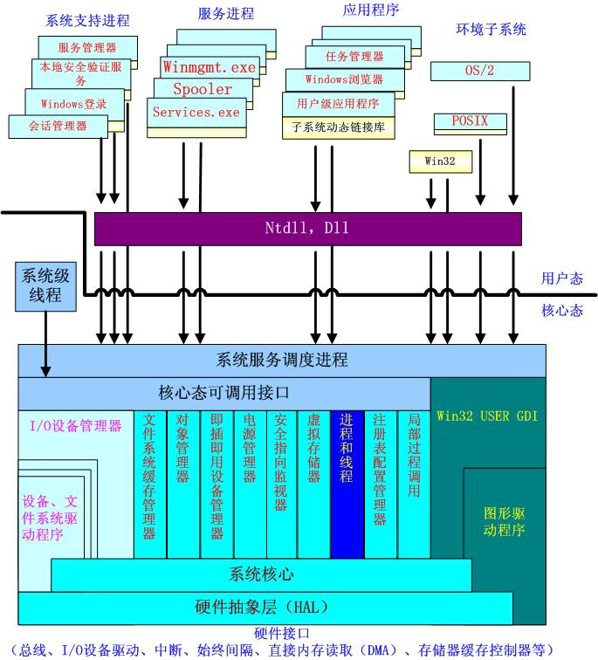
Architecture of Win 2k/XP

Slide 15
Topics of OS
Introduction and prerequisites knowledge (4~6 lessons)
Opinion of OS: resource manage VS extended machine
Concept: batch system/cocurrency/real-system
Knowledge about interruption, CPU, clock, DMA, storage system, bus, motherboard….
CPU management (8~10 lessons)
Concept: process/thread, CPU instruction
Process/thread scheduling
Interprocess communication
Memory management (8~10 lessons)
Concept: swapping, virtual memory, paging, segmentation
Memory allocation, relocation, protection and sharing
Multiprogramming, running image of thread
Device management (6~8 lessons)
Concept: DMA, I/O channel, I/O software
Working mechanism of different kinds of I/O devices
Dead lock and related processing

Slide 16
Topics of OS (cont.)
File system (Disk management) (6~8 lessons)
Concept: files, directories, volume, file format and system
Disk space management
File system design and implementation
File system security
System call and user interface (2~4 lessons)
Concept: soft interruption, hard interruption, CPU trap
Initialization and system service loading of OS
Interaction between user space and kernel spaces
Environment management (2 lessons)
Power management
Security and stability maintenance
Case analysis and advanced topics discussion (2 lessons)
Source code review of several OS
Research on OS and some academic topics

Slide 17
My goals in this course
My minimal expectation
Everyone can learn something
don’t waste your time
My strategy
Breadth & Depth in OS domain
Case study & discussion & thinking & analysis
My challenge
How to improve your passion of CS and OS
How to integrate the related knowledge and interactive with you

Slide 18
What about your goals?
Motivation and attitude
Smart and independent thinking
Experience about science, engineering and technology

Slide 19
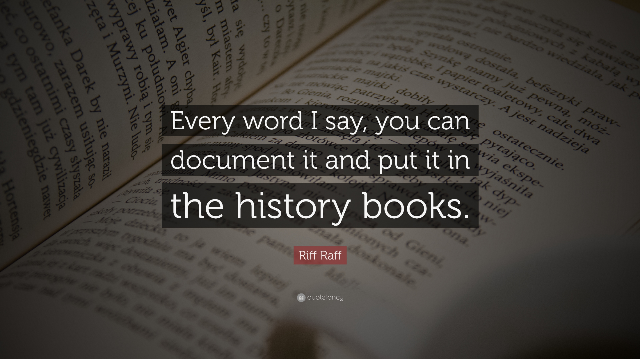
评分规则
大作业：OS改造开发 (50%)
期末考试(50%) 闭卷
会包含实验部分内容
以及其他各种各样的知识

Slide 20
Teaching books and reference
Teaching books
“现代操作系统”,机械工业出版社，Tanenbaum著
Reference books
操作系统概念（第七版）；Silberschatz、Galvin和Gagne著、郑扣根译；高等教育出版社，2010年
操作系统——精髓与设计原理（第七版）；William Stallings著，陈向群、陈渝译；电子工业出版社，2012年
“操作系统：设计与实现”，电子工业出版社，中译本
“操作系统－内核与设计原理”，电子工业出版社，William Stallings著，英文原版
“Windows操作系统原理”，机械工业出版社，陈向群

Slide 21
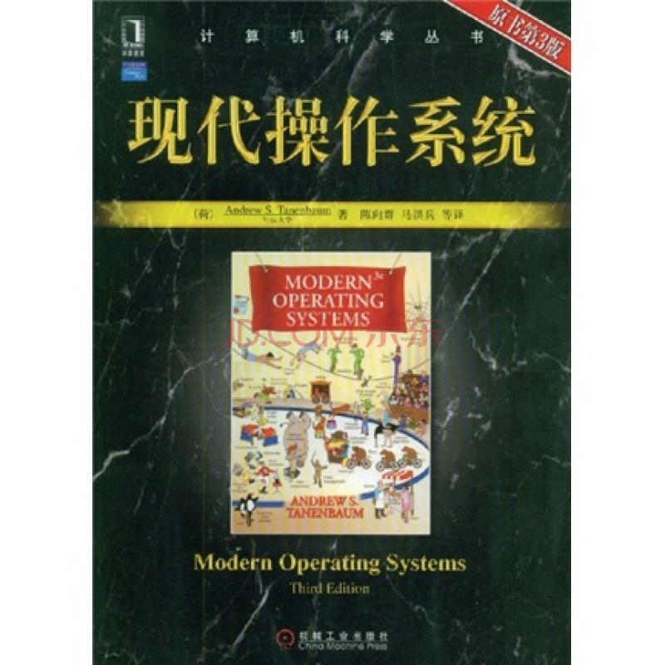
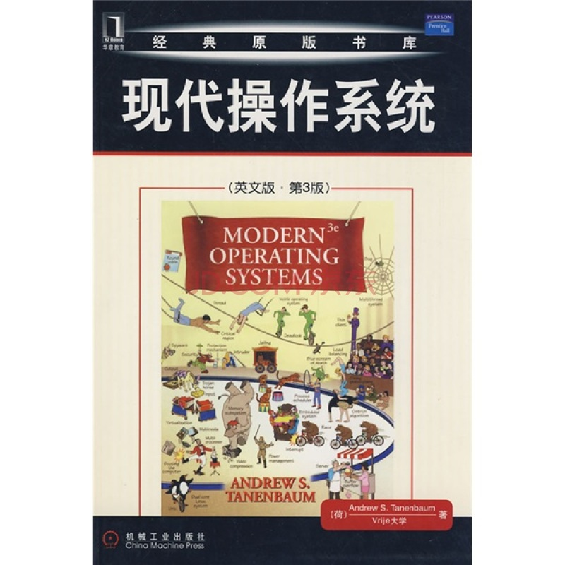
Teaching books and reference

Slide 22
Other reference books
操作系统教程 王素华 人民邮电出版社
计算机操作系统教程 张尧学史美林 清华大学出版社
计算机操作系统教程 周长林 左万历 高等教育出版社
操作系统基础 屠立德 屠祁 清华大学出版社
操作系统教程 孟庆昌 西安电子科大出版社
计算机操作系统 汤子瀛等 西安电子科大出版社
操作系统原理DOS篇 张昆苍 清华大学出版社
操作系统教程 孙钟秀主编 高等教育出版社
操作系统原理技术与编程 蒋静 徐志伟 机械工业出版社
Operating System Concept Abrahan Silberschatz,etc
Applied Operating System Concept Abrahan Silberschatz,etc

Slide 23
Overview of OS history
The motivation of OS
Using computer in an easier way
Using computer in a more efficient way
Provide more powerful functions based on hardware
The history of hardware
Vacuum tubes and plugboards: no OS existed
Transistors and batch systems
Integrated Circuits and multiprogramming
Personal computers
Network and digital world

Slide 24
History of OS: Stone Age
Prehistoric age of OS (1940s ~mid-1950s)
Famed persons: Babbage, Ada, Howard Aiken, John von Neumann, J. Presper Eckert and William Mauchley, Konrad Zuse (Germany)
They constructed computing machines with vacuum tubes
Programming is done in absolute machine language, which means changing the structure of circuit.
The primary function of computer is scientific computing
Please remember this age
The foundation of Computing Science and Technology
They dreamed of automatic computing machines, and they realized this dream with terrible basic facilities

Slide 25
History of OS: Bronze Age
Batch system (mid-1950s ~1965)
Famed persons & organizations & OS: IBM, DEC, IBM 7094/1401, FMS
Computer is consisted of transistors
Structure of the operating system
Batch process, a smart job scheduling method
On line VS Off line
Programming language: Fortran, Assember

Slide 26
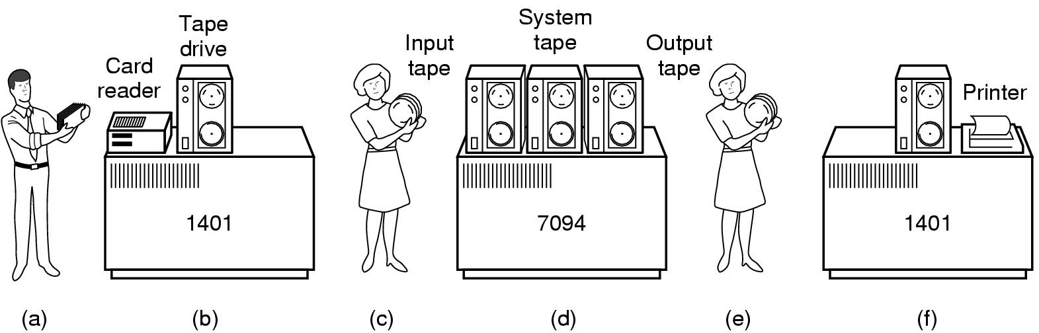
History of Operating Systems (1)
Early batch system
bring cards to 1401
read cards to tape
put tape on 7094 which does computing
put tape on 1401 which prints output
26

Slide 27
FMS: Bronze Age
$END
Data for program
$RUN
$LOAD
Fortran program
$FORTRAN
$JOB, 10,429754
Cherry Chen

Slide 28
History of OS: Industrial Age
Multiprogramming System (1965~1980)
Famed persons & organizations & OS: Intel, IBM OS/360, Multics, Ken Thompson and Unix, Tanenbaum and Minix, Linus and Linux
Industrial standard for computer and OS
Structure of the operating system
Compatible: the beginning of standard
Multiprogramming, Spooling, Time-sharing
Software engineering
Programming language: C, Fortran, Assembler

Slide 29
Multics: seed of modern OS
Multics (1963~ 1965~ 1969)
Multiplexed information and computing services
Another software dinosaurs
Multiprogramming and Time-sharing
Allocate CPU time to multi programs in simultaneous way
Time-sharing, one mainframe can support 100 online terminal

Slide 30




Multics: seed of modern OS
终端
主机

Slide 31
Multics: seed of modern OS
It seems that each job owns independent PCs
Timesharing: only one job can use CPU at any tick
OS manage only one PC register for all jobs

Slide 32
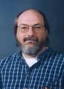
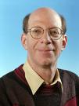

Ken Thompson: I want to play game
brilliantly achievement
Multics in 1965, Unix in 1969
B language, the precursor to Ritchie's C
QED in Unix, Belle in chess computer
Turing award in 1983,National Medal of Technology in 1999, Tsutomu Kanai Award in 1999
Minix and Linux
Andrew S.Tanenbaum (1980): mini unix
Linux(1991): Linus’s minix

Slide 33
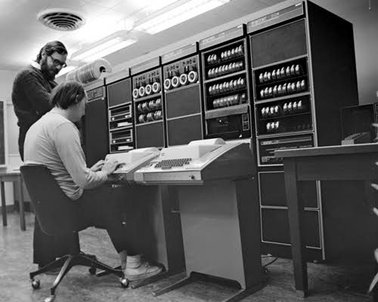
Ken Thompson

Slide 34
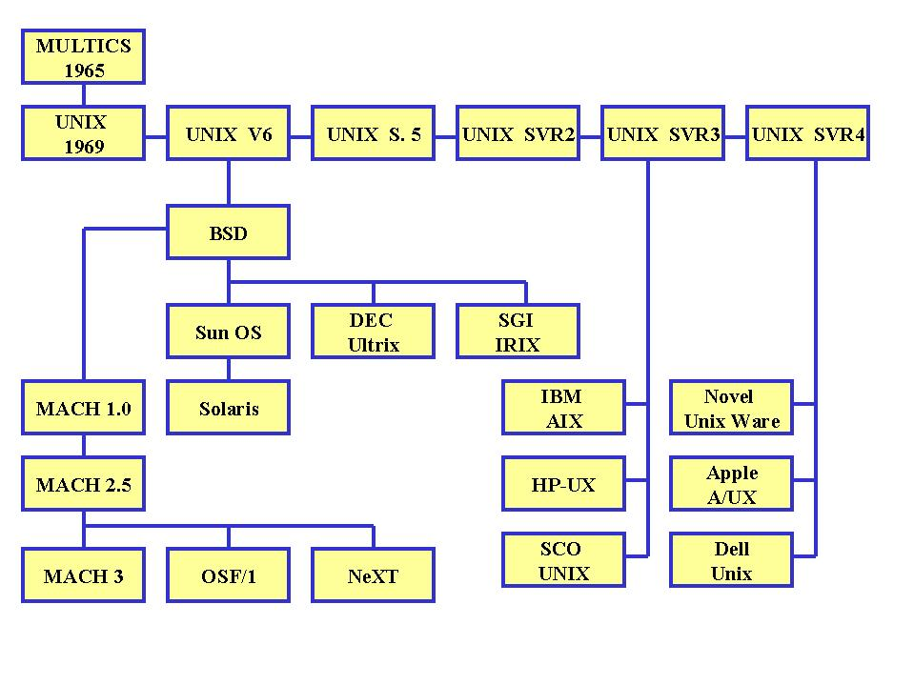
Unix family: more popular than CN&KN

Slide 35
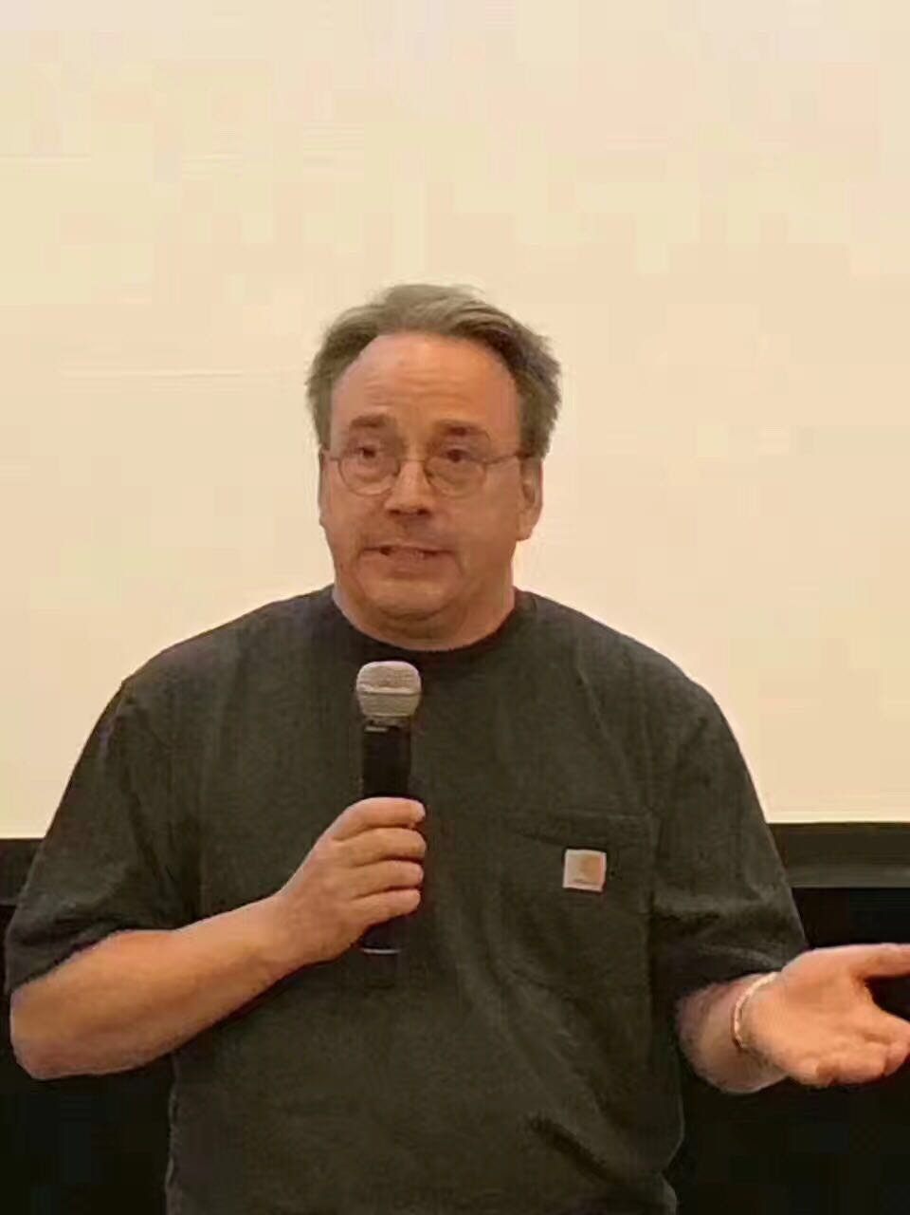
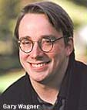
Linus Torvalds: Just do it
Linus’s minix = Linux
He create an OS for himself, also for the world
DIY: do it yourself, the world will be changed
Modern opinion for software
Open Mind: Everyone can change it
Team Work: All people work for it
The essential of Linux
Compatible and extendable
Efficiency and Security is the most important thing

Slide 36
Compatible and Soft Engineering
Compatible
Different purpose need different structures, different OS
It is too expensive for any company to maintain distinct and totally incompatible produce line
One produce line, series product, different functions
Software engineering
Compatible VS Integration
No way to write a software to meet conflicting requirements
Software dinosaurs: too complex, too enormous
IBM OS/360, released with more than 1000 bugs

Slide 37
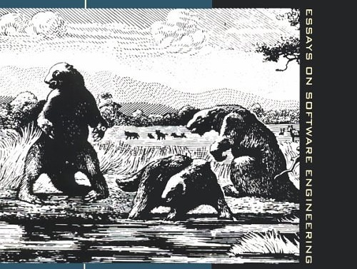
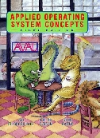
Compatible and Soft Engineering

Slide 38
History of OS: Golden Age
Personal Computer & Network (1981~)
Famed persons & organizations & OS: Gary Kildall and CP/M, Bill Gates and DOS, Steve Jobs and Mac, IBM OS/2, Open Source and GPL, Embedded system
Digital world based on computing
Structure of the operating system
GUI: virtual world constructed by computer
Distributed and Sharing: C/S,B/S, Grid…
Multiprogramming and parallel
Computer & Network: new world, new life

Slide 39
Gary Kildall: There was a chance for me…
CP/M
A successful OS that suitable for PC
Intel: they think that PC is valueless
Academic, Technology and Business
Academic: Find the essential of the world
Technology: Change the world in more efficient way
Business: Create a world based on law, science and technology

Slide 40
Bill Gates & Microsoft
Bill Gates
Find the request, and hold the chance
Law is more important than technology
The story of Microsoft
DOS: the first popular PC OS
Win32: GUI + WYSWYG
Win95: Bill cheated IBM, but changed the world
WinNT,2K,XP….

Slide 41
Steve Jobs & Macintosh
Steve Jobs
Make computer to be more interested
Apple, Lisa, Macintosh
The story of Steve Jobs
Doul Engelbar: father of GUI
Xerox PARC: omitted the value of GUI
Steve Jobs: more romantic than Bill Gates
Digital media world
Fashion & Immersion
efficient, effective, easy to learn, easy to remember, easy to apply to new problem

Slide 42
Future of OS: Nothing Impossible
Service and Intelligence (Now~)
From tool to service
From automatic machine to intelligent facility
Structure of the operating system
Micro-kernel operating system: RIG(1975), Mach(1984)
Mainframe OS: IBM OS/390
Embedded system: Vxworks, µcos-II
Free communication and Mobile computing
Intelligence and humanity
More complex, more powerful and more intelligent

Slide 43
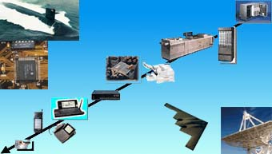
Future of OS: Nothing Impossible
电话交换设备
印刷机
零售设备
互联网服务器
复印机
移动通信
机顶盒
智能卡
计算机外设

Slide 44
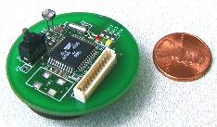
Future of OS: Nothing Impossible
美国加州伯克利大学研制：微型智能传感器，安装TinyOS

Slide 45
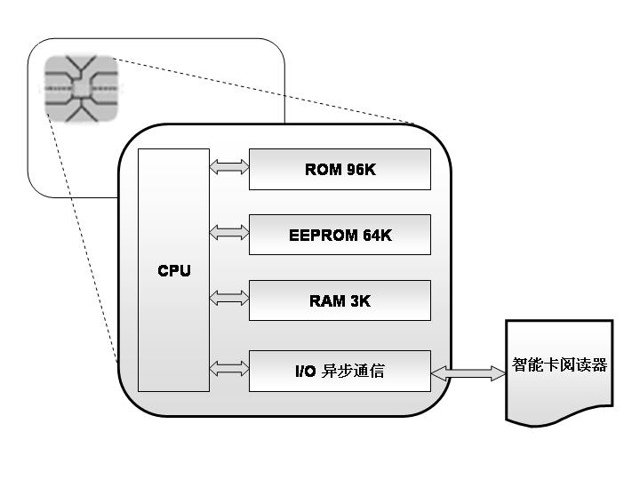
Future of OS: Nothing Impossible
在读写器与智能卡之间通过“命令-响应对”方式进行通信和控制
读写器发出操作命令，智能卡接收命令
操作系统对命令加以解释，完成命令的解密与校验
操作系统调用相应程序来进行数据处理，产生应答信息，加密后送给读写器

Slide 46
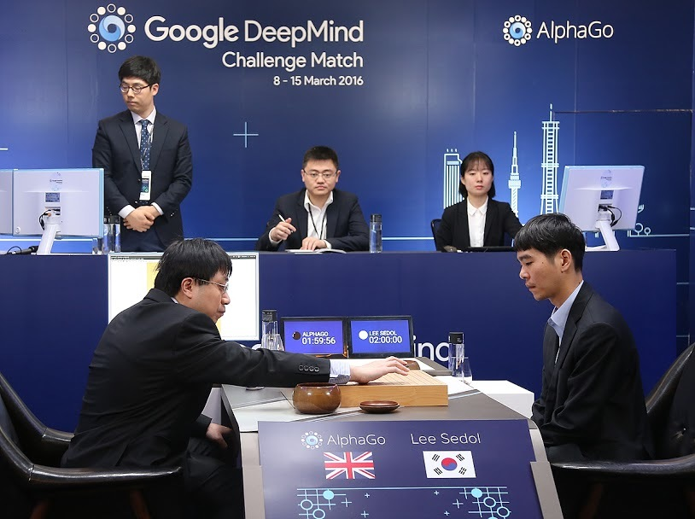
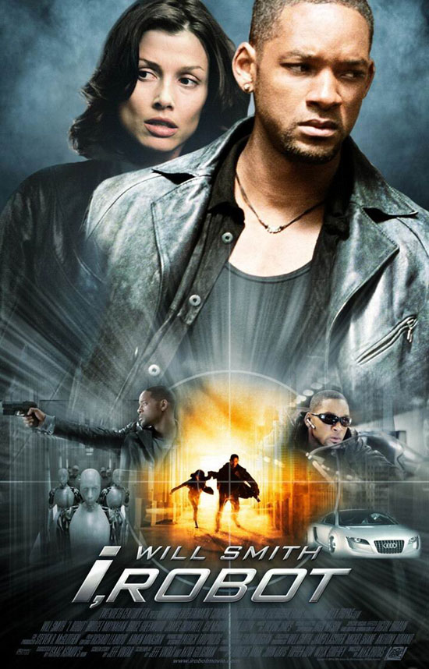
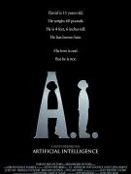
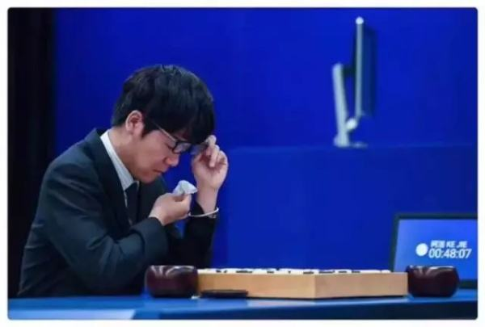
The culture of OS and Computing
Operating System
46
CITS, NanKai University
Powerful, Efficient and Convenient
The world is created by “lazy” guys (lazybones)
Recycling of concepts and ideas
Do you like this digital world?
Do you read this digital world?

Slide 47
三足鼎立
IOS: Apple
Android:
Google
&Motorola
Winphone:
Microsoft
& Nokia

Slide 48
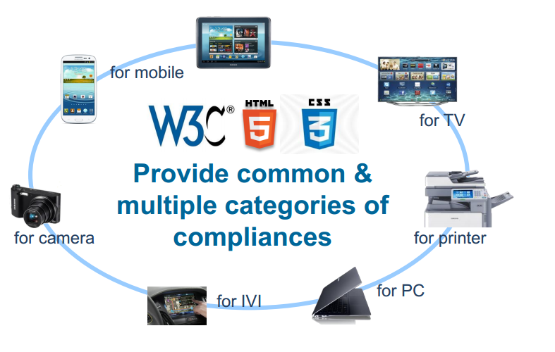
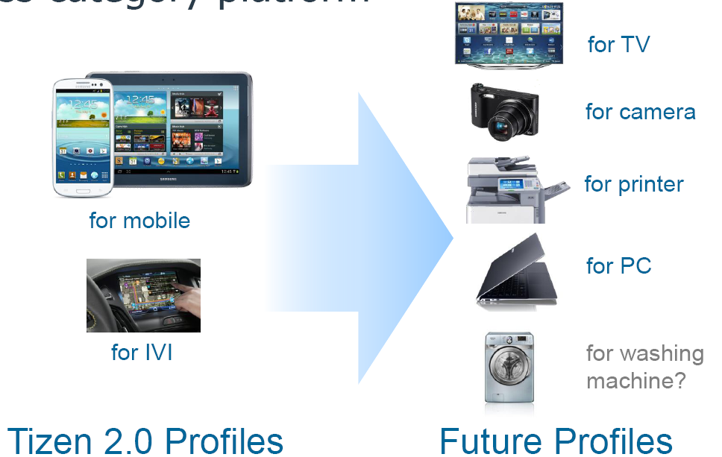
Tizen is,
Standard-based, cross category platform
Provide common & multiple categories of compliances
Open Source Platform
Tizen project resides within the Linux Foundation
Provides a robust and flexible environment for HTML5 based application

Slide 49
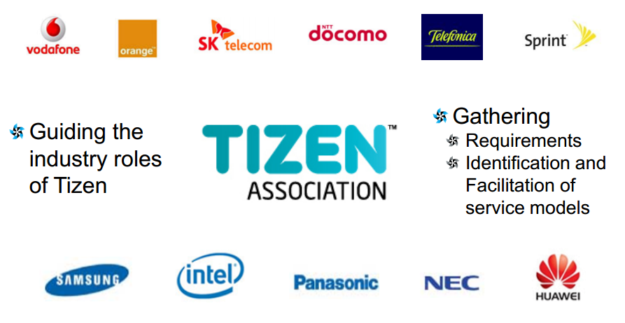
Industry Support
NEC, Panasonic, and Telefonica leaved Tizen Association.
Telefonica: Firefox Phone

Slide 50

Tizen Open Source Information
Visit
http://www.tizen.org
http://developer.tizen.org/sdk
http://source.tizen.org/
https://developer.tizen.org/documentation
Community
Mailing lists: http://www.tizen.org/community/mailing-lists
IRC Channel: #tizen
Wiki: https://www.tizen.org/community/wiki
JIRA: http://bugs.tizen.org
Tizen Developer Conference
https://www.tizen.org/conference

Slide 51
History of OS in CHINA
Operating System
51
CITS, NanKai University
mid-1960s ~ 1970s
YangfuQing & 150 System (1MIPS)
It was used in oil prospection
Mid-1970s
DJS200/XT2: developed with high-level programming language
1978, GX73 Multi-CPU real-time OS
1983, series of YHOS
Unix/Linux: COSIX, Hopen, Delta OS, Smart EOS,中软Linux, 红旗Linux, 东方Linux

Slide 52

哪里在做操作系统研究？
■ 顶尖大学的计算机科学部门
■ 计算机产业
旧时： Xerox (PARC), IBM, DEC (SRC), Bell Labs
现代： Microsoft, Google, Yahoo, IBM, HP, Sun, Intel, VMware, Amazon, …
国内：阿里巴巴、百度、华为…
■ 研究协会
ACM SIGOPS
USENIX

Slide 53
操作系统研究的顶级会议
■ ACM操作系统原理研讨会（SOSP）
ACM SIGOPS
每两年（奇数：1967-）
~20论文
■ USENIX操作系统设计和实现研讨会（OSDI）
USENIX
每两年（偶数：1994-）
~20论文

Slide 54
There is a saying
I hear, I forget
I see, I remember
I do, I understand

Slide 55
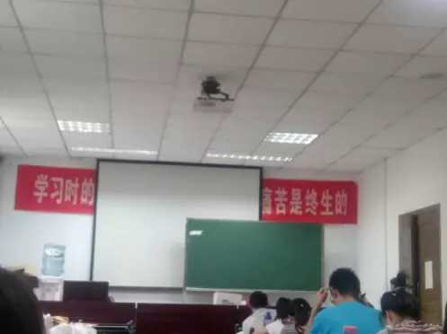
如何学习操作系统？
■ "不闻不若闻之，闻之不若见之，见之不若知之，知之不若行之；学至于行之而止矣。"
--荀子《儒效篇》
■ “天才是1%的灵感加上99%的汗水"
-- Thomas Edison
■ “困难，最好的和最有趣的二年级课程！”

Slide 56
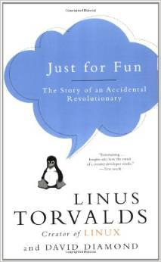
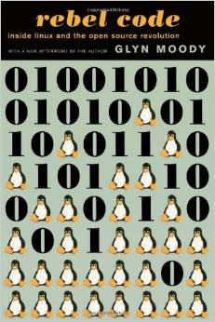
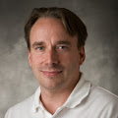
如何学习操作系统？

Slide 57
Thanks for your time! Questions & Answers

